Slide 1
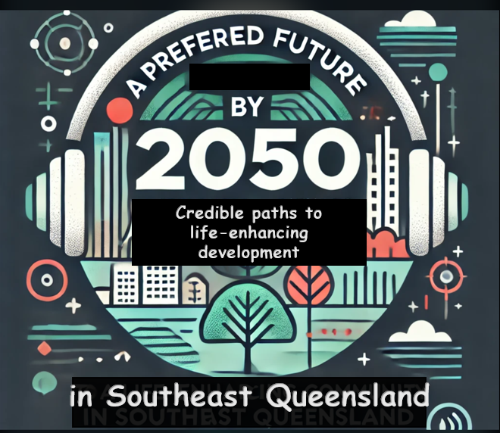
a podcast project proposal by HOPE INC. (AUSTRALIA)
SEEKING EXPRESSIONS OF INTEREST IN SUPPORT
Notes:
THIS PRESENTATION IS PART OF A PROJECT DEVELOPMENT CONSULTATION PROCESS RUN BEING RUN INTO EARLY 2025 BY NFP HOUSEHOLDERS’ OPTIONS TO PROTECT THE ENVIRONMENT (HOPE INC. AUSTRALIA) ALSO KNOWN SIMPLY AS HOPE INC.
HOPE is headquartered in Toowoomba S.E. Queensland and has been pursuing its mission of community capacity building to enhance environmental protection since the mid-1990s.
HOPE is now seeking expressions of interest in support of a new podcast project proposal.
The working title of this podcast series: ‘A Preferred Future by 2050: Credible Pathways Toward a Life-Enhancing Community in SEQ’ suggests its core purpose. To provide a set of widely accessible, inspiring, credible stories of alternative ways of doing development - which could help transition us toward a better, preferred future in this region in one generation.
HOPE has previous podcast development and broadcast experience gained in producing three previous series over the period 2020 – 2024.These were on: visions for a post pandemic economic recovery; trends in eco-social work practice; and stories showcasing Australian biodynamic agriculture.
This presentation is part of a fuller document set which can be supplied on request. It includes a more comprehensive project proposal document (5600 words) which contains initial podcast episode content suggestions, a production schedule, timeline and budget. There is also a short-read summary of the proposal (1600 words).
The proposal documents described, and the HOPE organisation website can be accessed by clicking on the embedded links in the relevant logo images on this slide.

Slide 2
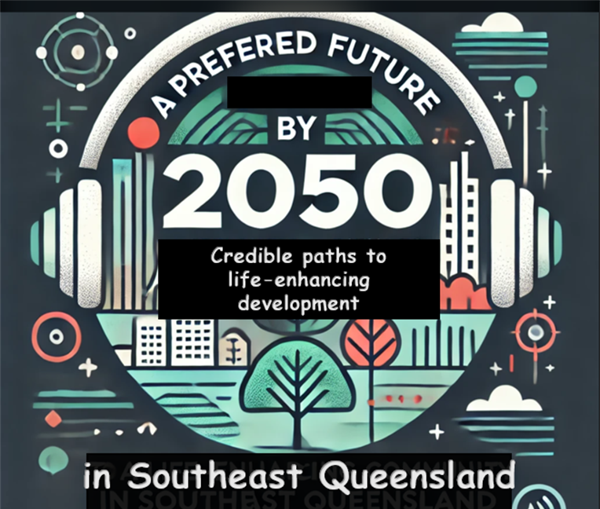
PURPOSE OF THE PROJECT two key objectives
Help create a credible citizen-shaped vision, story or portrait of a better, genuinely sustainable future for S.E. Queensland.
Help empower more assertive citizen political
and institutional demands for a rapid transition
toward that better future.
Notes:
THE OVERALL PURPOSE OF THE PROJECT IS TO EXPLORE THE CAPACITY OF THE PODCAST MEDIUM TO:
Help to develop in the mind of the audience a concrete and coherent set of pictures of the opportunities already available to us which could create a range of inspiring, life-enhancing solutions to our myriad and growing environmental, social, and economic challenges regionally, nationally and globally.
Such solutions already exist - from mandating meaningful greenhouse gas reduction targets to speeding up well planned renewable energy deployment; from providing programs for the authentic restoration of nature to greatly reducing plastic waste. From using higher levels of public finance to construct adequate amounts of well-planned social housing to introducing a range of universal basic income trials as a first step toward wider implementation.
The existing list of exciting innovatory alternatives to business-as-usual approaches to such issues is being expanded all the time. The podcast series would help bring some of these opportunities to wider public attention. Its guest interview stories, and discussion would help:
Outline how such solutions could be implemented into an urgently needed, just/fair transition toward a better regional future which leaves nobody behind. A future in which levels of economic prosperity, social fairness and environmental and nature protections have been greatly improved.
Identify the blocks and constraints acting to slow or even prevent the urgently needed implementation of innovative life enhancing opportunities and alternative development pathways into a transition to a better future.
Unpack the diverse modes of influence of such constraints. From individual and group psychology of fear of change to the political lobbying pressures of cynical, well financed vested interests. From the greenwash distractions of false claims of progress to the disgrace of captured and self-serving government and regulatory systems.
Highlight the mechanisms used by bad faith defenders of business as usual and in the process, help grow an alternative theory of change and increase the credibility of better ways of doing development in the mind of its audience.
In strategic terms the podcast series would encourage its audience to actively target government, business and institutional roadblocks to genuine progress. To better use the leverage of its collective power to demand authentic progressive change from leaders - across the environmental, social and economic challenges the podcast series identifies.
Finally, the podcast series website could act as an online rallying point to help grow a community of interest in progressive change demands for the region. The website could become an initial hub of information exchange on values methods and strategies of use in effecting visionary change.
Here is a quote which goes to the basic purpose of this project - as attributed to the US political theorist John Schaar:
‘The future is not some place we are going, but one we are creating. The paths are not to be found but made. And the activity of making them changes both the maker and the destination.’
In similar vein, Ian Lowe – Australian thought leader, author and professor of science, technology, and society made much the same point when he said:
‘Remember that the future is not somewhere we are going, it is something we are creating. Every day we do things that make some futures more probable and others less likely.’

Slide 3
Research Element providing a case study
Assess the podcast’s capacity to influence
citizen engagement and mobilisation
on the issues the series covers.
Help grow the limited research on podcast medium influence to support environmental protection and system level progressive reform.
Notes:
SOME REASONS FOR INCORPORATING A RESEARCH ELEMENT
It is important that research is done to help validate the outcomes of a project like this. To demonstrate whether the project achieved what it set out to achieve in community capacity building terms across its lifetime.
It is important that the podcast series itself models a best practice approach of applying evidence-based solutions to meet our growing developmental challenges. That principle is often sadly lacking in our current and failing business as usual approaches to development.
If project outcomes can be validated by research findings, then the project could become an influential capacity building case study, and a possible template for replication elsewhere.
Some research questions that could be posed in this element of the project:
Can the podcast series and its dedicated website provide an actionable advocacy roadmap as the series builds?
Can the podcast series help empower stronger public political and institutional demands to implement innovative development ideas as showcased in the series ?
Can such a podcast project contribute significantly toward mobilising collective citizen led demands for the numerous system level reforms we need if we are to attain a better, preferred future in SE QLD and elsewhere?
Can such a podcast project assist in diverting SEQ from its current, suboptimal, business-as-usual development path - through contributing toward a hypothesised increase in public progressive development advocacy?
The community capacity building utility of the podcast series could be diverse. The following outcomes are envisaged at this stage - and all could be subject to research evaluation:
Provide a generic educative benefit to the audience on the value of creating citizen/community-shaped visions to guide future development. This outcome could have generic educative value for listeners who encounter the series from any location, in or out of the SE QLD region.
Showcase existing positive case studies of better alternative development approaches already in play. In the process throwing light back onto the regressive forces acting to slow or prevent such progress.
Provide alternative answers to a question in the public mind of ‘What Works?’ or ‘What Will Work Best for Me in Future?’
Use episode audio, associated text show notes and dedicated website resources to engage groups of individuals in learning circle type processes, in or out of the region. Such work could occur either online or face to face.
Promote the series to members of community organisations whose missions are aligned with series objectives, thus supporting the value of common cause coalition.
Encourage the podcast series audience within the region to consider joining those same organisations - to help develop an increased common cause advocacy voice.
Produce online conference and webinar events linked to episode content and subsequent audience feedback as the series evolves.

Slide 4
BACKGROUND FACTORS
The urgency to achieve a just transition to a better future.
The availability of solutions now which could speed that transition in Australia and our region.
The retrograde forces that are slowing the needed transition.
Notes:
BACKGROUND FACTORS:
In this crucial decade of urgently needed development transitions we are not moving fast enough to slow and halt accelerating damage to our life-sustaining planetary boundaries, let alone to enhance the health and well-being of human society and the natural world.
The evidence for that conclusion comes from a raft of robust, well-validated scientific and evidence-based research and reports in recent years.
Findings reveal the extent of human overshoot of crucial planetary boundaries and link to the lived community experience of increasingly dangerous disruptions to a previously stable climate and well-functioning natural systems.
On the robust evidence of existing trends of damage and disruption to such systems, individual and community human health and wellbeing will be damaged increasingly and are set to decline overall across forthcoming decades.
The laggard response to the truly frightening consequences of accelerating human caused damage to our life-sustaining planetary systems is not primarily one due to a lack of viable solutions and strategies to deal with the challenges.
The solutions exist in abundance. For example, we have well researched strategies and means to speed the transition to a carbon negative economy, to reduce and eventually eliminate plastic waste, to make a proper protective place for nature and to repair damaged ecosystems. That list goes on.
We know what to do to turn some of these major problems around before they wreck global society as it currently functions – so why aren’t we flat out doing it?
One well validated cause of the laggard response mentioned is the pushback made against proposed solutions by powerful vested interests – for example in the fossil fuel, land development and digital media sectors.
A common motivation across these sectors of bad faith actors is to resist any attempt at change or reform which would threaten their business model and profit margins.
Depressingly, many government and regulatory institutions - which should be helping speed the urgently needed just transition - in the interests of discharging their responsibility to protect the wellbeing and security of their citizens and communities – are, in practice, colluding with bad faith actors to resist that transition.
Furthermore, such actors, though diverse in background, share certain tactics drawn from a common playbook. For instance, they may:
Oppose progressive reforms by manipulating fear of change in society. That fear is often particularly strong in marginalised and vulnerable sectors of the community which bad faith actors may attempt to demonise and scapegoat. They do that to help polarise opinion on required reforms and distract attention away from their consistent efforts to reject any change which might impede their self-serving agendas.
Use greenwash and other forms of propaganda to cloak their responsibility in helping create many of the interlinked environmental, social and economic challenges faced by global society, and distract public attention away from much needed system level solutions.

Slide 5
Theory of Change
Citizens around the world want stronger action from their political and business leaders on climate, social, and economic challenges. BUT:
Currently that civic preference is either too ambivalent, too collusive or too reactive to achieve timely reforms.
Notes:
EXPLAINING THE IMPOTENCY OF CIVIC AND COMMUNITY CALLS FOR ACTION ON CLIMATE AND OTHER DEVELOPMENT CHALLENGES
There are a host of theories out there to explain why the long established, majority preference of international citizens for a better future, whether in terms of environmental, social or economic outcomes, does not translate into timely, substantive progressive change on the ground.
Perhaps the ultimate answer to the current impotency and impasse of civic calls for genuine progress lies within the psychology of the myriad cognitive distortions the human mind is prey to. A prime example is the concept of system justification theory. On a positive note, useful lessons can be drawn from the field of cognitive psychology and linguistics in relation to strengthening public advocacy for progressive change.
Whatever the precise mechanisms at play in preventing majority public concern for progressive reform – the current stasis demonstrates that:
Widespread civic preference for a better future, as currently expressed, does not achieve substantive change in the face of opposing bad faith forces.
There is insufficient, citizen-driven, system level reform advocacy.
Most democratic governments and businesses remain entrenched in destructive business-as-usual practices - and bad faith actors are given free rein to pursue their self-interested agendas.
What is the best way to tackle this abysmal failure of responsible governance and institutional response? To tackle egregious system level inaction in the face of so many interlinked and worsening challenges?
One answer is that we need continuous, stronger, mass citizen-led insistence that our leaders and institutions implement the urgently needed systemic transformations and transitions that are required. That is the theory of change context upon which this podcast project is premised.
Such civic demands can be strengthened by using tactics of mass public protest and nonviolent civil disobedience, financial divestment strategies, creating deliberative democracy representation of citizens, electing supportive political representatives. The list goes on.
Such civic demands could also be more strongly anchored and motivated by providing a set of credible, evidence-based visionary scenarios of a better, more ecologically healthy, socially fair and economically prosperous society. A future society which is more than possible to create and one which is clearly superior to business-as-usual options.
That sort of inspiring belief, in the feasibility of achieving progressive change through implementing visionary alternatives to business as usual, is evidenced in the quotations below. Visionary belief and hope have first to be created in the public mind however before they can be turned into reality. Helping to create some of those visions is a key objective of this podcast project proposal.
QUOTES on the necessity of having a future vision to guide progressive reform:
Ian Lowe – Australian thought leader, author and professor of science, technology, and society made much the same point when he said:
‘Remember that the future is not somewhere we are going, it is something we are creating. Every day we do things that make some futures more probable and others less likely.’
Donella Meadows, American environmental scientist, educator, and writer
‘If we don’t know where we want to go, it makes little difference that we make great progress.’ (1994)

Slide 6
PRODUCTION FORMAT
A baseline series of 6–8 interviews.
Each episode to tell an inspiring story or stories of progressive system level transition and the tools employed.
Baseline episodes will solicit audience feedback.
Notes:
THE INITIAL PRODUCTION FORMAT OF THE SERIES WILL BE BASED UPON:
A baseline series of 6–8 interviews conducted with a wide range of guests who can speak knowledgeably from either specialist knowledge, lived experience or both – about inspiring solutions, strategies and case studies which demonstrate progressive development change and transition in action right now. Outline suggestions for the initial episodes is contained in the full proposal document for the project.
The initial series will point to the future progressive development opportunities which could be seized and implemented rapidly. In the process that will throw light back onto the regressive forces acting to slow or prevent such progress - and beg the question of why the wider community and civic society continue to allow this to happen.
The baseline group of episodes will also be used to solicit active audience feedback and suggestions for future podcast development and improvement. For example, inviting suggestions for future series topics to be included and guests invited. And how audience inclusivity in and engagement with the series can be maximised.
The podcast series will wherever possible incorporate effective communication techniques and messaging drawn from recent research in cognitive linguistic, group psychology and other social sciences. And it will help explain the implications of this research to its audience in straightforward terms. The educative value of this series element could produce several audience benefits.
For example, in helping to explain the malign influence of propaganda (e.g. greenwash) and how to counter it. As well as explaining the power of motivated reasoning and in/out group psychology as it can affect personal decision making. The role of narrative structures and techniques to convey effective messages would also be included.
A female and male host will conduct guest interviews, interact and dialogue for explanatory benefit at various points within each episode. For example, by providing an orienting introduction to the key topic of each episode and in the summary and synthesis of guest talking points at closure.
Each interview will focus on:
Evidence-based challenges and solutions.
Constraints to implementation.
Citizen actions which could be taken to help accelerate change.

Slide 7
Distribution
Broadcast to a generic podcast audience via RSS feed and other platforms such as YouTube.
In addition, promote to specific sector interests with anticipated aligned values.
Notes:
THE PODCAST MEDIUM
Podcasting as a broadcast medium has grown hugely over the last twenty years or so. There are now millions of podcast episodes available and an estimated worldwide global audience of over 500,000 listeners. A summary of podcasting and its continuing potential to engage audiences is given in the full project proposal document which can be downloaded from the Google Drive link provided in the first and last slide of this PowerPoint.
The main RSS feed platforms used by this project might use primarily Podbean, Spotify and Apple podcasts - with the latter two providers being the most popular in Australia. The RSS distributed series could also be adapted for broadcast on YouTube and platforms such as Soundcloud - which could provide further audience segments.
Specific promotion efforts would be initially concentrated on NFP and community support organisations, deliberative democracy networks and online platforms. Other targets might include diverse organisations and initiatives which have stated or expected values aligned with achieving progressive change through civic activism across economic, social or environmental sectors.
The research community with interest in the podcast medium and its applications in community capacity building would be another sector worth approaching to gauge support interest the project.

Slide 8
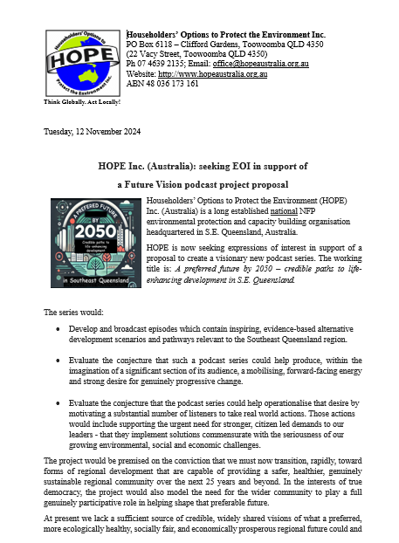
POSSIBLE NEXT STEPS
If you want to become actively involved in project development, would you consider:
Providing a letter of support?
Becoming a guest interviewer or interviewee for podcast episodes?
Suggesting potential guests for future podcast episodes?
Providing financial support or suggesting funding sources?
Offering some other kind of support?

Slide 9
FOLLOW UP CONTACT DETAILS
To provide feedback or to seek further discussion please contact
Andrew Nicholson (project instigator) E: anicholsona@gmail.com
M: 0411 082 028
or
HOPE Inc. (Australia) office@hopeaustralia.org.au
P: 07 4639 2135

